Slide 1


Digital Media Solution

Slide 2



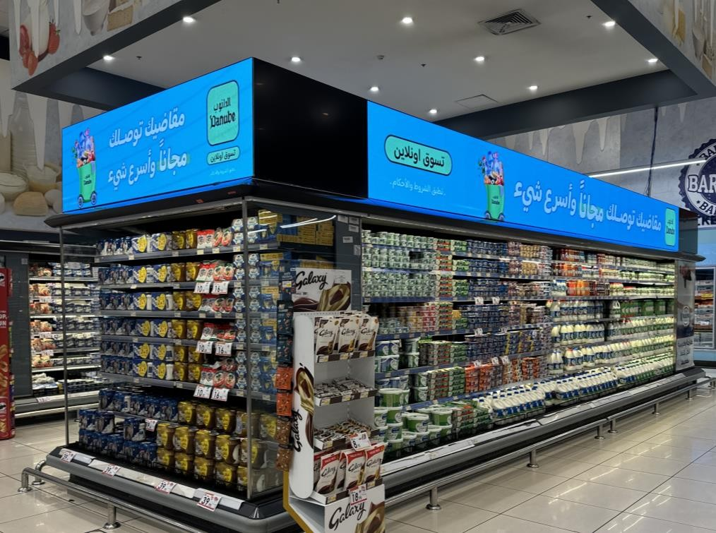

ONSKREEN
ONSKREEN's new solution for the Saudi market marks a breakthrough in consumer engagement at point of sale. Utilizing dynamic digital displays, interactive elements, and data-driven strategies, ONSKREEN empowers brands to stand out in high-traffic areas and connect more effectively with shoppers and consumers. This new approach not only boosts brand visibility but also delivers key insights into shopper behavior, allowing brands to adapt and grow in the competitive retail environment.

Slide 3


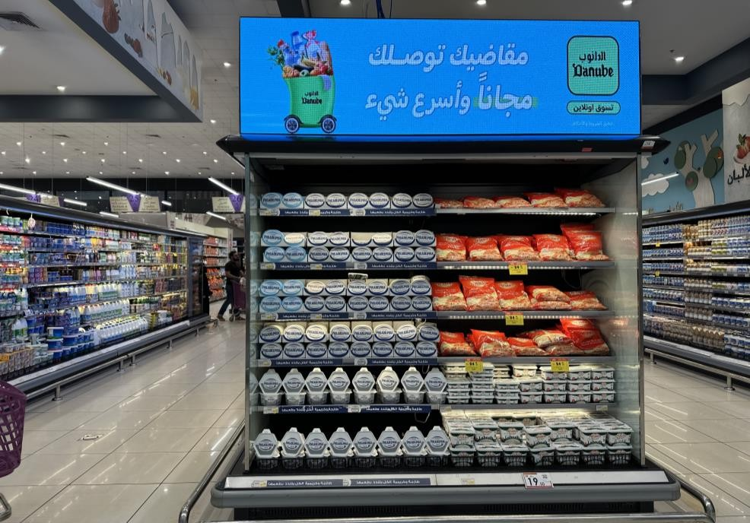
ONSKREEN’S
LATEST SOLUTION FOR THE SAUDI MARKET
ONSKREEN has introduced a groundbreaking solution tailored for the Saudi Arabian retail market, aimed at enhancing brand visibility and improving communication with supermarket consumers. The solution is strategically focused on areas with the highest foot traffic and sales potential and aims at winning the FMOT

Slide 4

Revolutionizing in market communication through advertising with dynamic, high-visibility digital communication spaces.
MISSION
VISION
To be the leading provider of in-store digital advertising solutions, driving sales and enhancing consumer engagement for our clients.

Slide 5


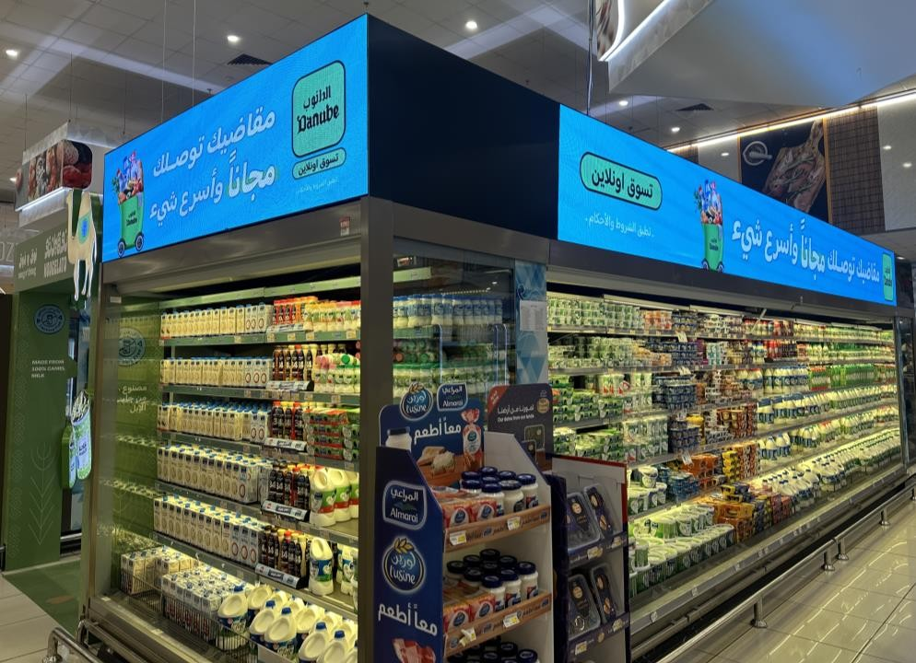




WHY ONSKREEN?
Increased Sales:
Driving higher sales conversation via perfectly placed brand visibility and customer engagement
Brand Awareness:
Strong brand Visibility directly at the SHELF and in the ISLE
FMOT:
OWN The First Moment of Truth: Capture shopper's attention the instant they enter the category.
Flexibility:
Easy to update and manage ad content in real time.
Analytics:
Detailed insights into ad performance and consumer behavior.

Slide 6

AVERAGE MONTHLY FOOTFALL
JUMAA CENTER
175,000
BD ROTANA
125,000
NAHDA 235,000
KHALDIA 250,000
NAKHLA 125,000
PANORAMA 200,000
ARBAEEN 170,000
TAHLIA 2
190,000

Slide 7




ONSKREEN MEDIA
KEY FEATURES
Interactive
Screens
Strategically placed interactive digital screens captivate shoppers with vibrant visuals and engaging content.
Content
Management
Real-time content updates allow brands to dynamically showcase promotions, new products, and special offers, tailored to the time of day or customer behavior.
Prime
Locations
ONSKREEN identifies the high-traffic areas in supermarkets to maximize visibility, sales, and return on investment.
Promotional
Campaigns
Brands can create and manage targeted promotional campaigns that are linked to loyalty rewards or special store events.

Slide 8
BRAND BENEFITS
Increased Visibility:
Brands can significantly boost their visibility in the retail environment by utilizing Perfectly placed digital display solutions in high-traffic areas
Enhanced Engagement:
Features designed to capture shopper attention and drive interaction, leading to increased customer satisfaction and longer store visits.
Improved Communication:
Direct customer communication with shoppers through tailored content
Data-Driven Decisions:
Data analytics and performance metrics enable brands to tailor their strategies and track the effectiveness of their campaigns

Slide 9
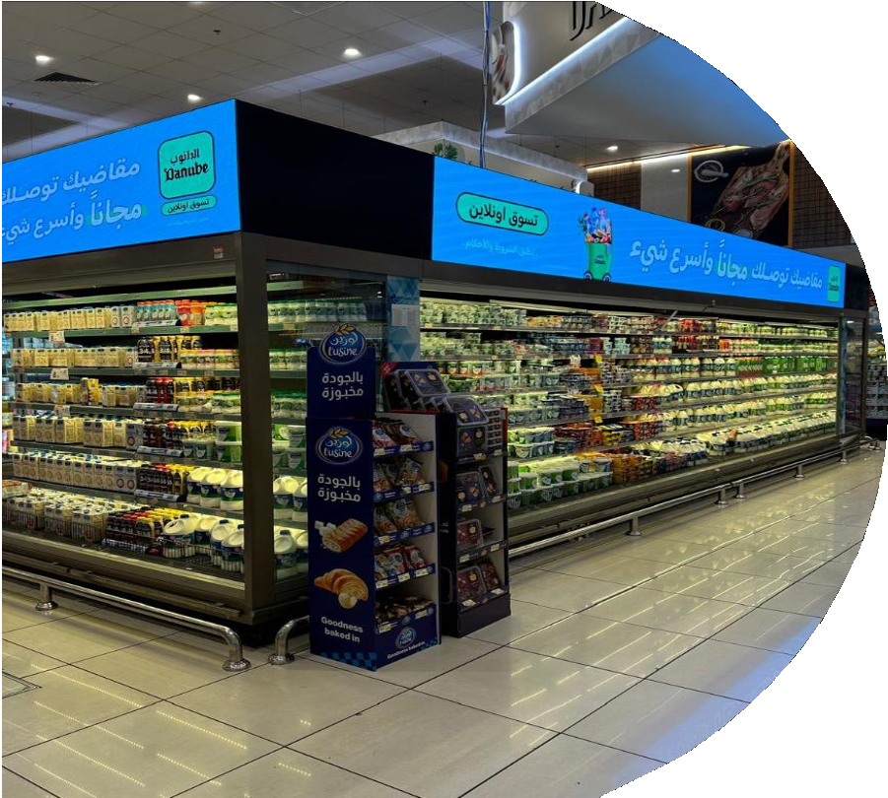



Partner Retailers
Click to Play

Slide 10



MEDIA Space
HYPER STORES
DIGITAL Solution
POSITIONING
Covering the top 10 Danube & Bindawood stores with the highest revenue/footfall
Up to 250 meters of high visibility screens across the kingdom
Covering highest traffic aisles in the hypermarkets to maximize brand visibility

Slide 11
MEDIA COVERAGE
S.No | Store name | Location | Area | No of screens | Size Measured
 |  |  |  |  | length | Height
1 | Danube Panorama | Riyadh | Chiller | 1 | 19 | 0.62
 |  |  | Gondola | 2 | 2.3 | 0.62
2 | Danube Al Nakhla | Riyadh | Chiller | 1 | 7.5 | 0.62
 |  |  | Gondola | 2 | 2.3 | 0.62
3 | Danube Jumaa Center | Khobar | Chiller | 1 | 17 | 0.62
 |  |  | Gondola | 2 | 2.3 | 0.62
4 | Danube Arbaeen | Jeddah | Chiller | 2 | 7.5 | 0.62
 |  |  | Gondola | 2 | 2.3 | 0.62
5 | Danube Nahda | Jeddah | Chiller | 1 | 10 | 0.62
 |  |  | Gondola | 2 | 2.3 | 0.62
6 | Danube Tahliya 2 | Jeddah | Chiller | 1 | 7.5 | 0.62
 |  |  | Gondola | 2 | 2.55 | 0.62
7 | Danube Khaldiya | Jeddah | Full Chiller Branding | 1 | 36 | 0.62
8 | Danube Rotana | Madina | Chiller | 2 | 11 | 0.62
 |  |  | Gondola | 1 | 2.3 | 0.62

Slide 12

4 MAIN CITIES
TOP 10 STORES
CITY | # Of Locations
RIYADH | DANUBE PANORAMA (2 Gondolas – 1 Category) DAUBE Nakheel (2 Gondolas – 1 Category)
JEDDAH | DANUBE ARBAEEN (2 Gondolas / 2 Categories) DANUBE NAHDA (2 Gondolas / 1 Category) DANUBE TAHLIYA 2 (2 Gondolas / 1 Category) DANUBE KHALDIYA (All Chilled Categories)
DAMMAM | DANUBE JUMAA CENTER (2 Gondolas – 1 Category)
MADINAH | BINDAWOOD ROTANA (2 Gondolas – 1 Category)

Slide 13
INDIVIDUAL RATE CARD
Individual Rate Card
Branding Element | Description | Duration | Gross Rate
Category Digital Header / Side | Ad Duration: 10 Secs Loop: 40 secs | 1 Month | SAR 30,000
Category Digital Header / Side | Full Takeover | 1 Month | SAR 90,000
Gondola Digital Header / Unit | Full Takeover | 2 Weeks | SAR 6,500
Discount Policy
1 Month | 3 Months | 6 Months
0% | Up to 15% | 5 Months Paid + 1 Month FREE
0% | Up to 15% | 5 Months Paid + 1 Month FREE
0% | Up to 15% | 5 Months Paid + 1 Month FREE

Slide 14
CIRCUIT RATE CARD
Danube Khaldiya – Jeddah
Danube Nahda – Jeddah
Danube Nakhla – Riyadh
Danube Arbaeen - Jeddah
Danube Panorama – Riyadh
Danube Tahliya 2 – Jeddah
Danube Jumaa – Khobar
Bin Dawood Rotana - Madinah
Circuit1
Circuit2
Individual Rate Card
Branding Element | Description | Duration | Gross Rate
Category Digital Header / 4 Sides / Circuit | Ad Duration: 10 Secs Loop: 40 secs | 1 Month | SAR 100,000
Category Digital Header / 4 Sides / Circuit | Full Takeover | 1 Month | SAR 300,000
Gondola Digital Header / 4 GE Units / Circuit | Full Takeover | 2 Weeks | SAR 20,000
Discount Policy
1 Month | 3 Months | 6 Months
0% | Up to 15% | 5 Months Paid + 1 Month FREE
0% | Up to 15% | 5 Months Paid + 1 Month FREE
0% | Up to 15% | 5 Months Paid + 1 Month FREE

Slide 15
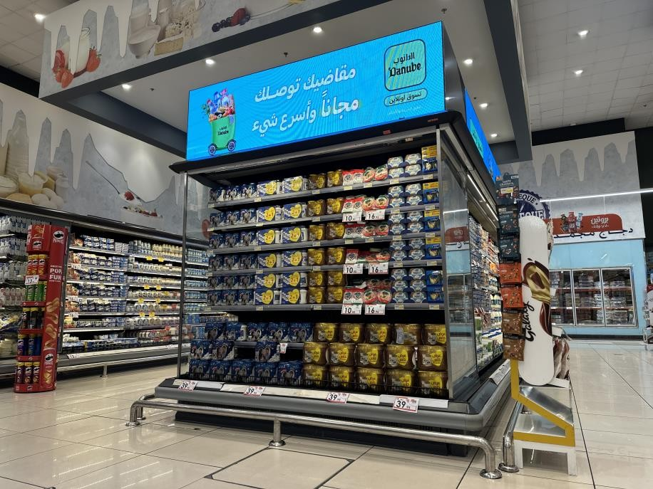
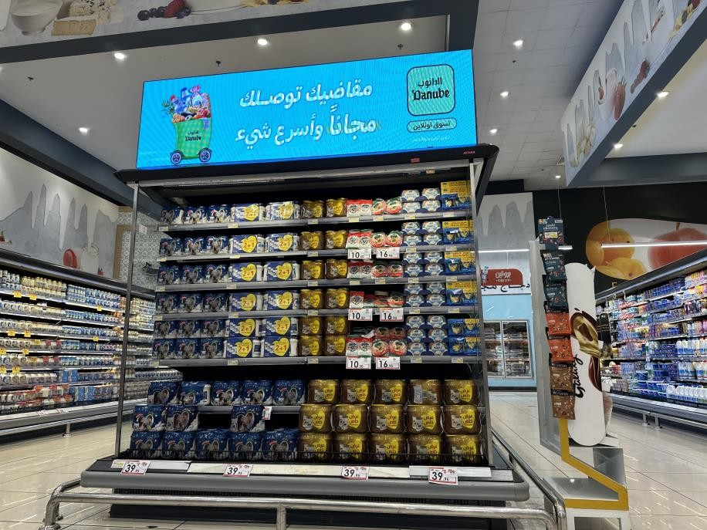

Slide 16
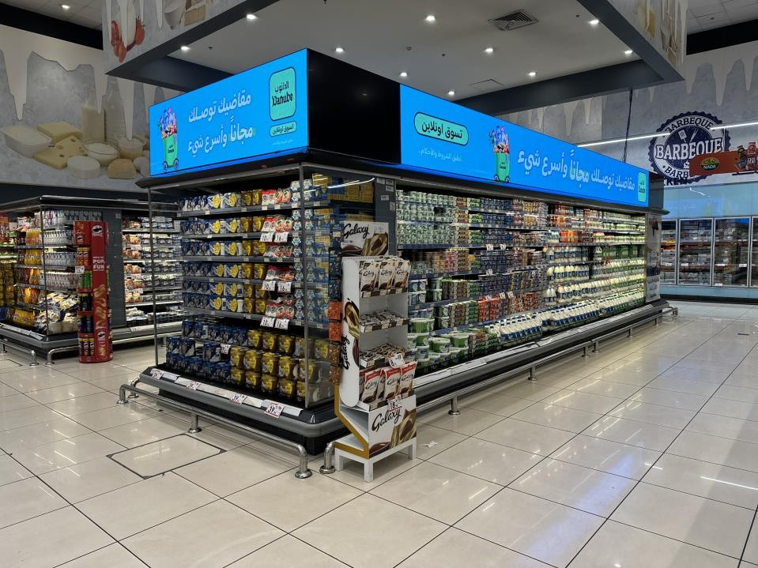
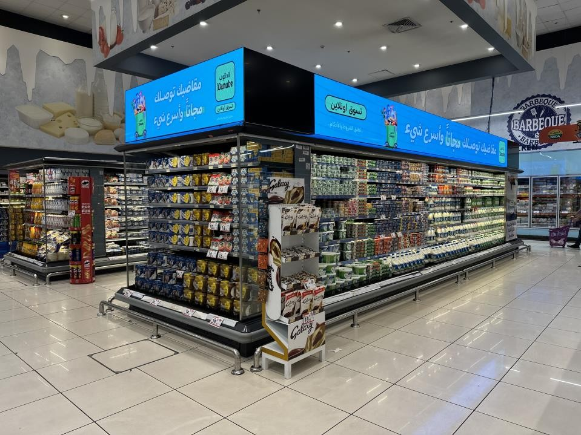

Slide 17
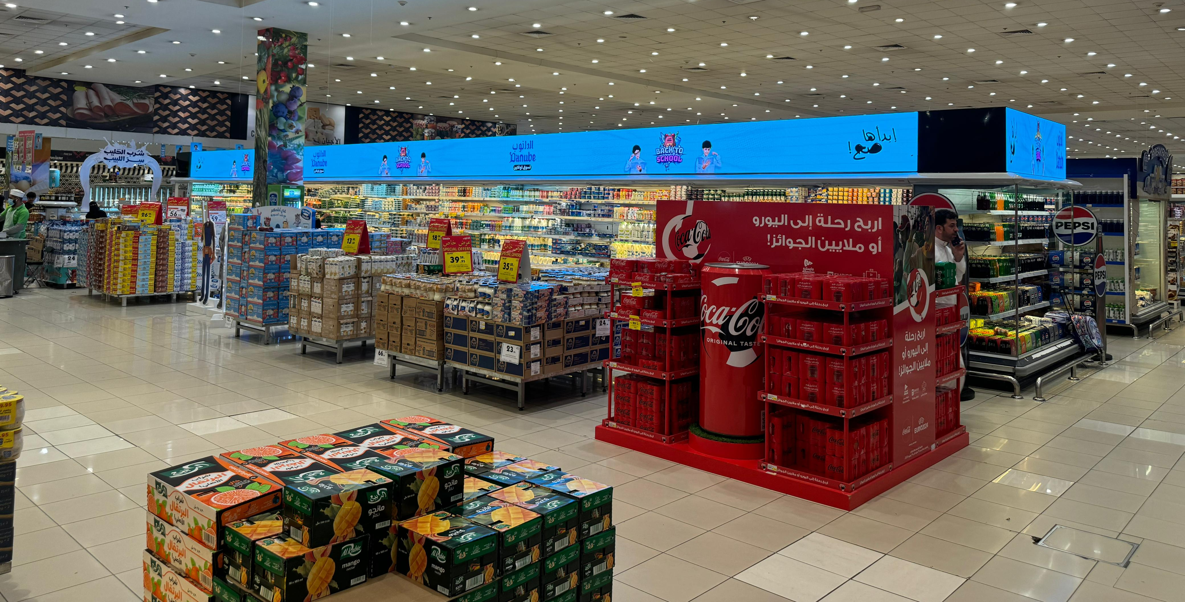

Slide 18
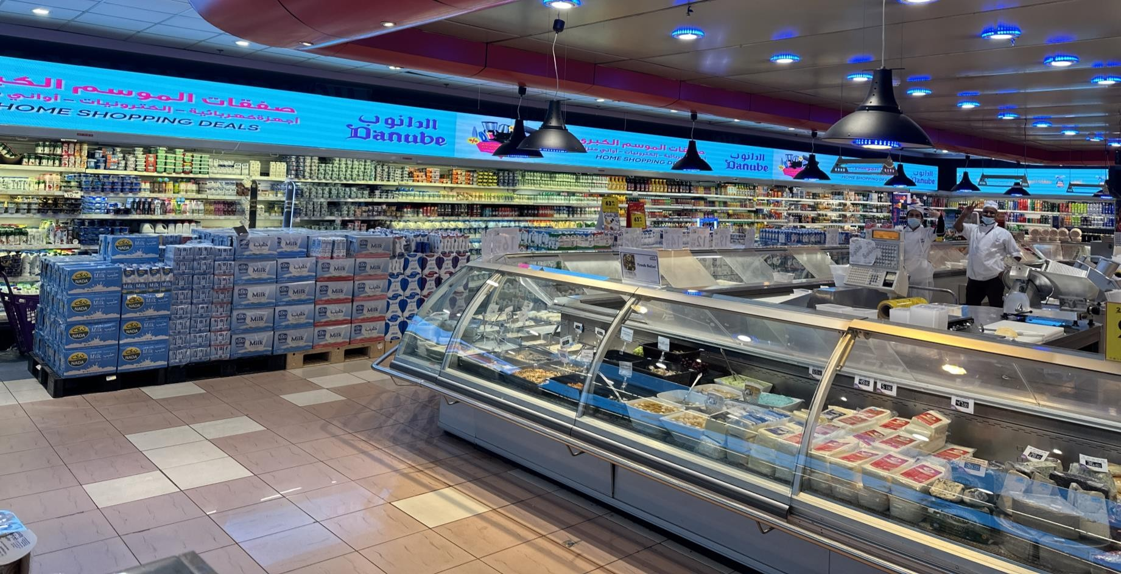

Slide 19
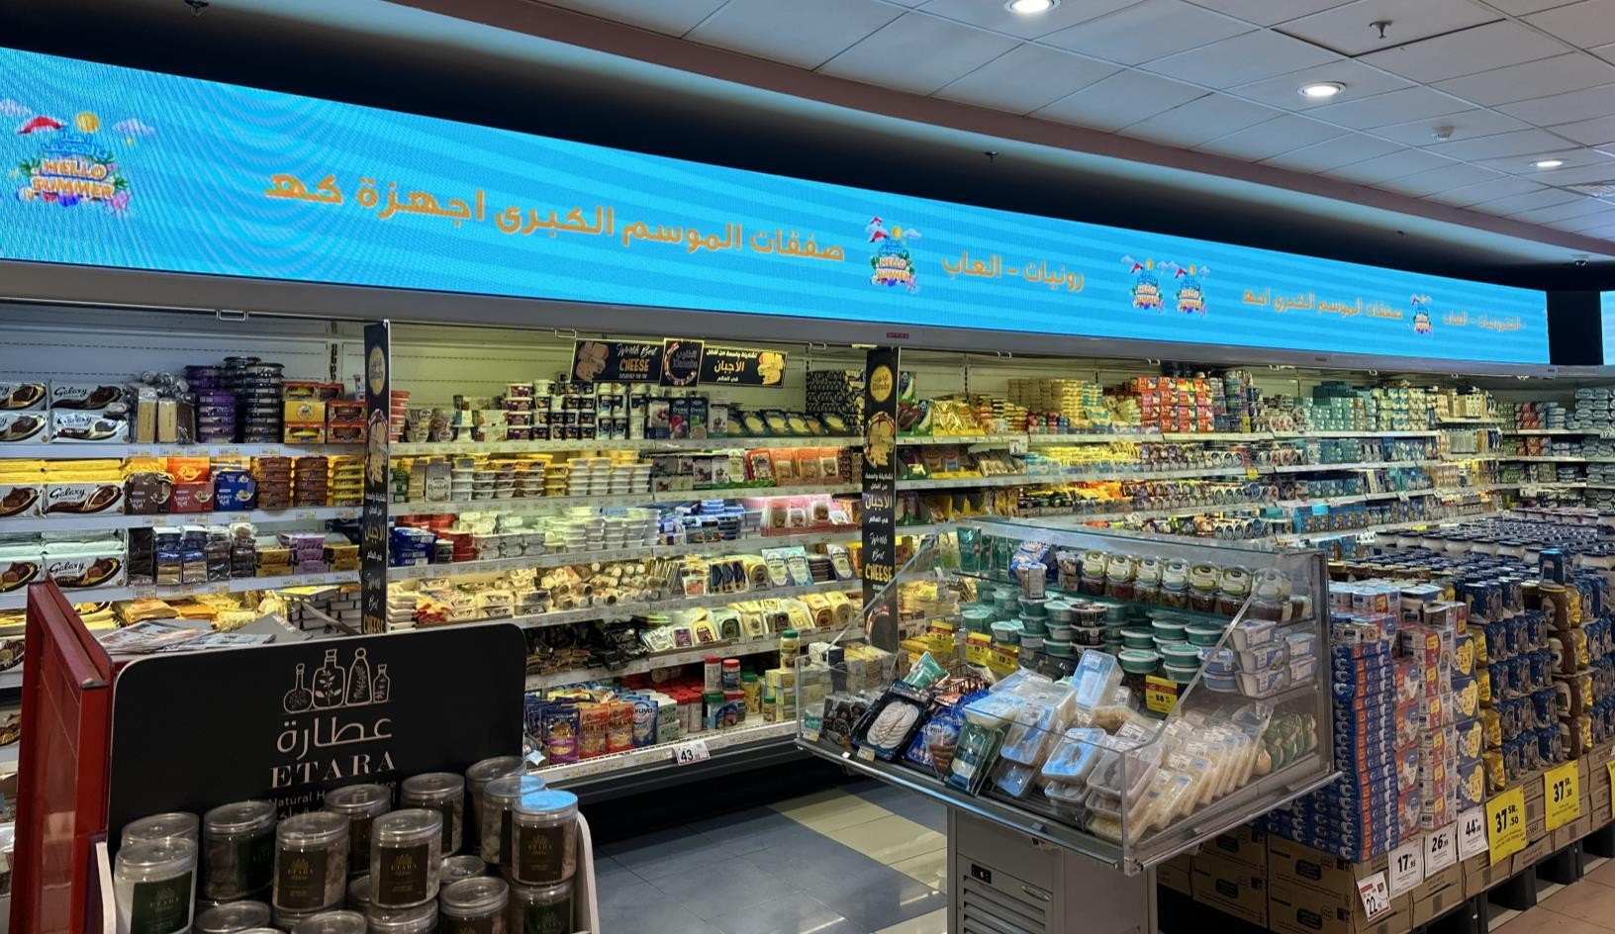

Slide 20
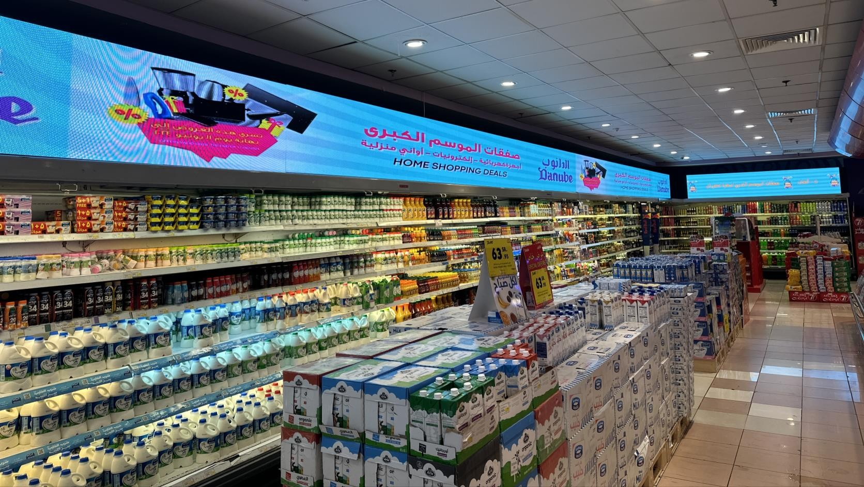

Slide 21


THAN YOU
sales@onskreenmedia.com
+971 55 955 9625

